Slide 1

Library Management System
t

Slide 2
Grade | ID | NAME
 | 20210300 | خالد سامح محمد عبد السميع
 | 20210295 | حليمة رمضان صلاح
 | 20210296 | حمادة عادل ابراهيم محمد
 | 20210297 | حمدى عبد المبدى محمود اسماعيل
 | 20210327 | رحمه محمد عاشور
 | 20210968 | مني ممدوح محمد
 | 20210523 | عبد الرحمن محمد احمد
.

Slide 3
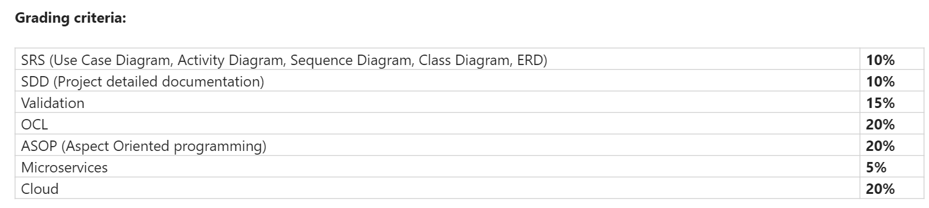
.
.

Slide 4
Library Management System Overview
The main objective of the Library Management System is to provide an efficient and organized way to manage library resources, user accounts, and borrowing activities.
System Components:
Librarian : Responsible for
CRUD operation( ADD , READ , UPDATE , DELETE ) : Librarian can manage books by adding, read book records, updating, and deleting book records.
filter books : Librarian can filter books by ISBN or rack number.

Slide 5
Library Management System Overview
managing Borrow request
Librarian can manage borrowed book requests and set return dates.
managing user accounts
Librarian can manage user accounts by approve or reject
Normal User : Can
Register search for books, borrow books, and view borrowing history

Slide 6
Library Management System Overview
System : Handles user requests, performs CRUD operations, and communicates with the Database.
Database: Stores book information, user accounts, and borrowing records.
Diagrams : ( use case, Activity, Sequence, Class, ERD)

Slide 7






Functional Requirements Librarian Functions

Slide 8
Login : Authenticate librarian credentials. : The system must allow the librarian to log in to the system using the account that was created : If the login credentials are correct, the website will verify the librarian's account and grant them access to the website. : If the login credentials are incorrect, the librarian may need to try again or reset their password.

Slide 9
Logout : The system shall allow Librarian to log out of it.
Manage Books : The system allows the ability to librarian to Add a new book.
: The system allows the ability to librarian to View list of books.
: The system allows the ability to librarian to Update book details.
: The system allows the ability to librarian to Delete a book.
: The system allows the ability to librarian to Read a book.
1

Slide 10
Filter Books : The system shall allow Librarian to Filter books by ISBN. : The system shall allow Librarian to Filter books by rack number.
.
Manage User Accounts : The system shall allow Librarian to Approve user registration : The system shall allow Librarian to reject user registration

Slide 11
Manage Borrowed Requests : The system shall allow Librarian to View borrowed book requests. : The system shall allow Librarian to Set return dates for borrowed books.
.

Slide 12
Functional Requirements Librarian Functions
.

Slide 13
sing up : The system shall allow a non registered user to create a new account. : The system shall require the following information from the user: Username-mail, Password, F-name, L-name. : The system shall store user’s information in Database.
.

Slide 14
Login : Authenticate user credentials. : The system must allow the user to log in to the system using the account that was created : If the login credentials are correct, the website will verify the user's account and grant them access to the website. : If the login credentials are incorrect, the user may need to try again or reset their password.
.

Slide 15
Logout : The system shall allow user to log out of it.
Search Books : The system shall allow user to Search books by title, author, or ISBN Then display the details of the book to User.
Send Borrow Request : The system shall allow user to end request to borrow a book.
.

Slide 16
Show Borrowed Books : The system shall allow to View list of borrowed book to user .
Return Book The user must return the book, and if the book's borrowing date has expired, a fine must be paid.
Cansel Borrow The user can cancel or modify the borrow if the book is not available.
.

Slide 17

Non -Functional Requirements

Slide 18
Compatibility : The website should be connected to the internet. : All features and front-end works on the system should be supported from all browsers. : The system should be compatible with different devices and operating systems, and support multiple languages.

Slide 19
Performance : The system shall respond to the request from the user in less than 3 seconds. : The system shall be reliable and flexible. : the system shall on average operate without failure for as long a time as possible. : the system shall handle more than 1user simultaneously.
.

Slide 20
Maintainability : The system shall be easy to change/update .
.
Serviceability
: The system shall be easy to maintain, including tasks such as monitoring the system, repairing problems that arise, adding and removing users from the system.

Slide 21
Data integrity
The system shall be described by accuracy, completeness, and consistency of data mean safety of data and security
interface : The system must be with a good interface , any user can understand it.
.

Slide 22
.
Security
Authentication: All users (librarians and normal users) must authenticate using a username and password.
Data Encryption: User passwords and sensitive data should be encrypted to ensure data security.
Safety :The system shall ensure that only authorized users are able to gain access

Slide 23
.
Privacy
The system should comply with data protection regulations to ensure user privacy.
Usability
User-Friendly Interface: The system should have an intuitive and user-friendly interface for both librarians and normal users.

Slide 24
.
Reliability
: The system should be available 99.9% of the time.
: The system shall be reliable and do not have data validation failures.
Scalability
: The system should be able to handle a growing number of books and users without performance degradation.

Slide 25
Diagrams

Slide 26
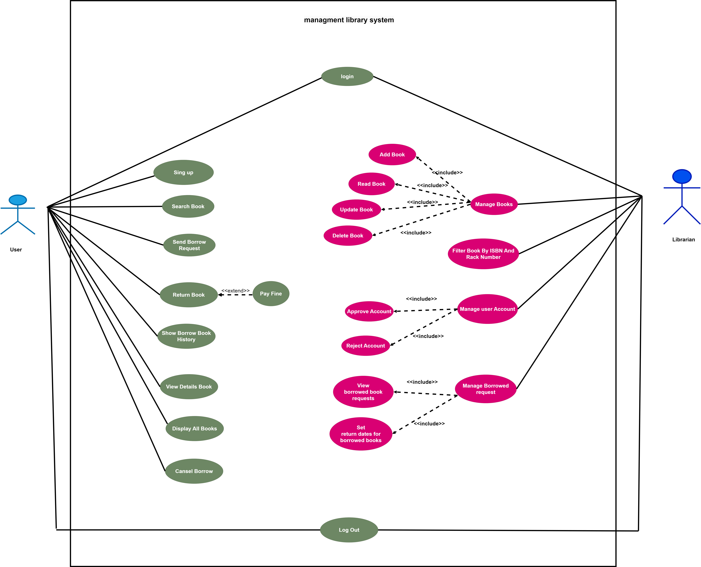
Use Case
.

Slide 27
Use case name | Login
Actor | librarian and user
Pre condition | The librarian and user accesses the system login page.
Description | 1: The librarian and user enters the username and password. 2: The system validates the credentials. 3: The system grants access and displays the librarian or user dashboard.
Post condition | User accounts are updated based on the librarian's actions.
Use case name | Sign up
Actor | user
Pre condition | The user is not sign up to system
Description | User will enter the register interface , and user should fill his first name , last name , gmail and his phone and to create a account to him in the system
Post condition | The system check his personal information and sign him up successfully

Slide 28
Use case name | Manage Books
Actor | librarian
Pre condition | The librarian is logged into the system
Description | 1:The librarian selects the "Manage Books" option. 2: The librarian can choose to add, view, update, or delete a book. 3: The system updates the book database accordingly.
Post condition | The book database reflects the librarian's changes..
Use case name | Filter Books
Actor | Librarian
Pre condition | The librarian is logged into the system.
Description | 1:The librarian selects the "Filter Books" option. 2: The librarian enters the ISBN or rack number to filter books. 3: The system displays the filtered list of books.
Post condition | The librarian views the filtered list of books.

Slide 29
Use case name | Manage User Accounts
Actor | librarian
Pre condition | The librarian is logged into the system.
Description | 1:The librarian selects the "Manage User Accounts" option. 2: The librarian can approve or reject user registration requests. 3: The system updates the user account status accordingly.
Post condition | User accounts are updated based on the librarian's actions.
Use case name | Manage Borrowed Requests
Actor | Librarian
Pre condition | The librarian is logged into the system.
Description | 1:The librarian selects the "Manage Borrowed Requests" option. 2: The librarian views and manages borrowed book requests. 3: The system updates the borrowed book status and return dates.
Post condition | Borrowed book requests are managed and updated.

Slide 30
Use case name | Search Books
Actor | User
Pre condition | The User is logged into the system.
Description | 1:The normal user selects the "Search Books" option. 2: The normal user enters the search criteria (title, author, or ISBN). 3: The system displays the search results.
Post condition | The normal user views the search results.
Use case name | Send Borrow Request
Actor | User
Pre condition | The normal user is logged into the system.
Description | 1:The normal user selects a book to borrow. 2: The normal user sends a borrow request to the librarian. 3: The system updates the borrowed book status 4: user can cansel or update his request if the book is not available .
Post condition | The borrow request is sent to the librarian for approval.

Slide 31
User case name | Show Borrowed Books
Actor | User
Pre-condition | The normal user is logged into the system.
Description | 1: The normal user selects the "Show Borrowed Books" option. 2: The system displays the list of borrowed books for the user.
Post-condition | The normal user views their borrowed books.
Use case name | Return book
Actor | User
Pre condition | The normal user is logged into the system.
Description | 1: The normal user navigates to the "Return Book" section. 2: The normal user selects the book(s) they wish to return from the list of borrowed books. 3: if the book's borrowing date has expired, a fine must be paid.

Slide 32
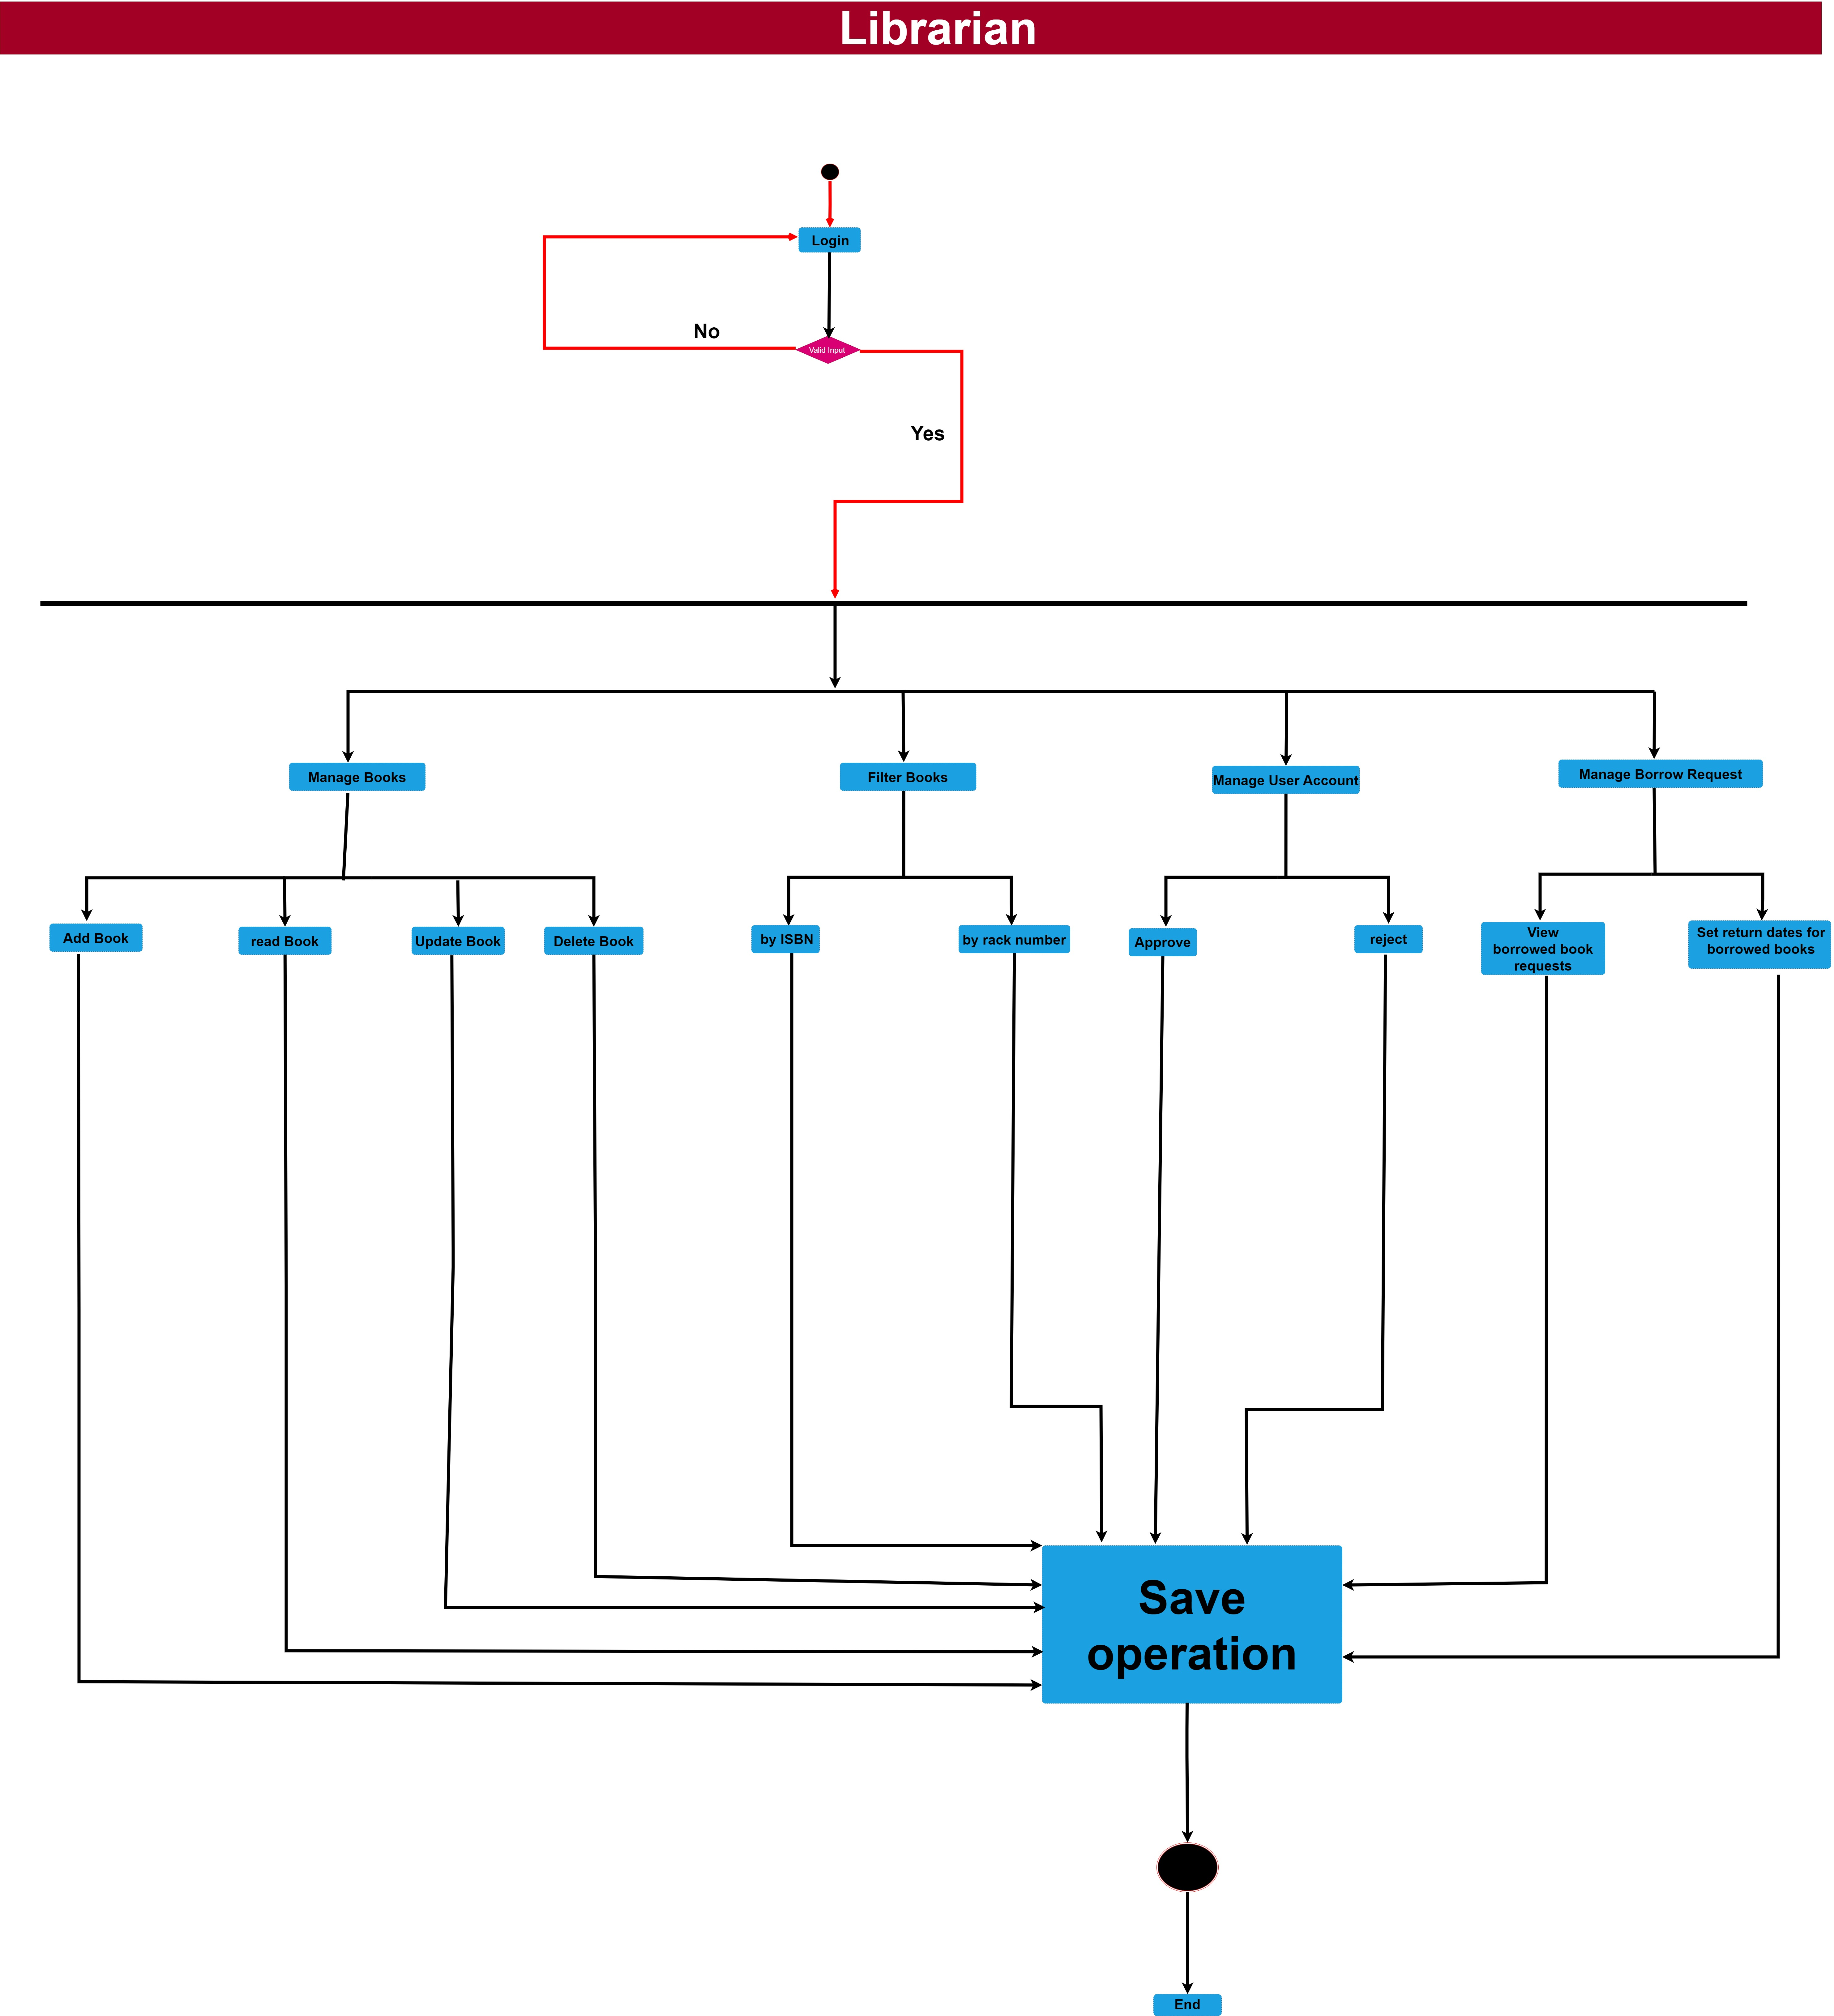
Activity diagram for Librarian
.

Slide 33
Activity Diagram Description FOR Librarian
* Start Activity … The process begins when the actor decides to perform an action within the system.
* Login ... The librarian selects the "Login" option to authenticate into the system.
*Manage Books ... The librarian selects the "Manage Books" option to perform CRUD operations on books.
*Filter Books ... The librarian selects the "Filter Books" option to filter books by ISBN or rack number.
* Manage User Accounts
The librarian selects the "Manage User Accounts" option to approve or reject user registration requests.
* Manage Borrowed Requestshe librarian selects the "Manage Borrowed Requests" option to handle borrowed book requests and set return dates.

Slide 34
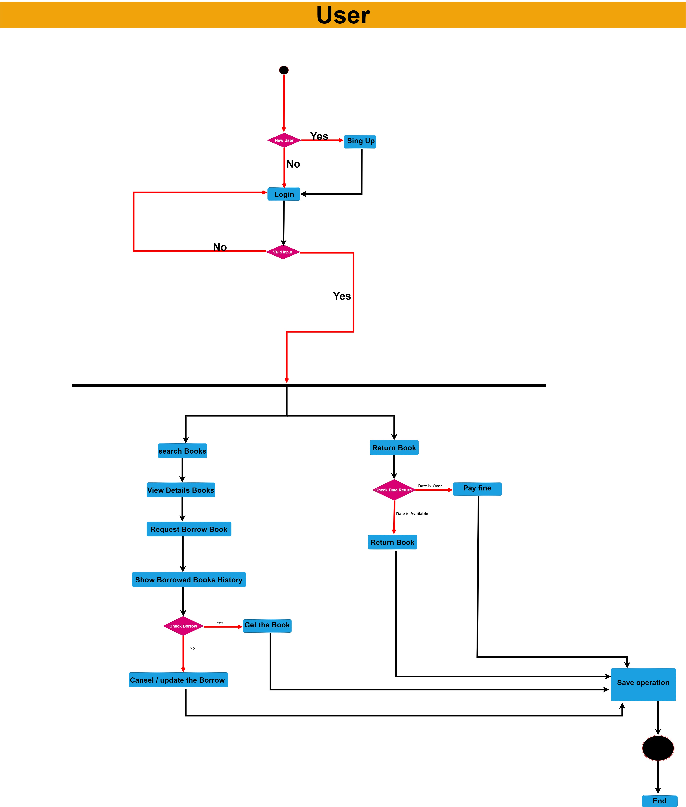
Activity diagram for User
.

Slide 35
Activity Diagram Description FOR USER
* This description provides a comprehensive overview of the activity diagram based on the requirements for the Library Management System, detailing the activities, transitions, and flow involved in the process.
* The normal user can only send a borrow request after registering and logging in.
* If the librarian approves a user registration, the user can log in to the system.
If the libr
* If the librarian rejects a user registration, the user cannot log in until the registration is approved.
* The librarian manages book requests and sets return dates based on user requests

Slide 36
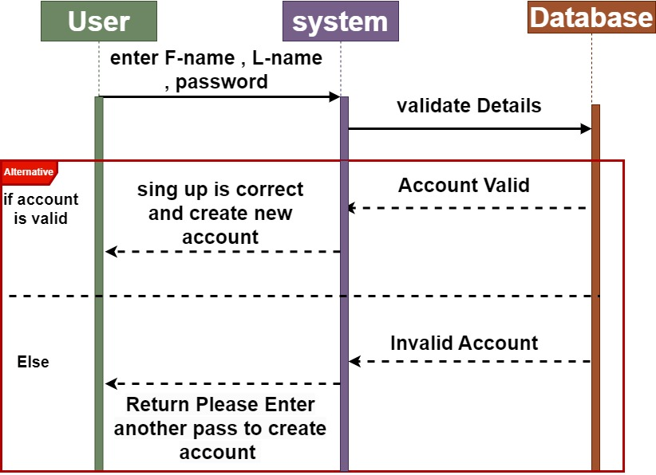
Sequence diagram sing up for user
.

Slide 37
sing up Description FOR user
* The User sends a signup request with user details (Username, Password, Email, etc.) to the System.
* The System validates the user details .
*The System sends the validation result (Valid/Invalid) to the User.
*If the details are valid:
The System adds the new user to the Database.
* If the details are invalid: The System sends the signup failure message to theUser.

Slide 38
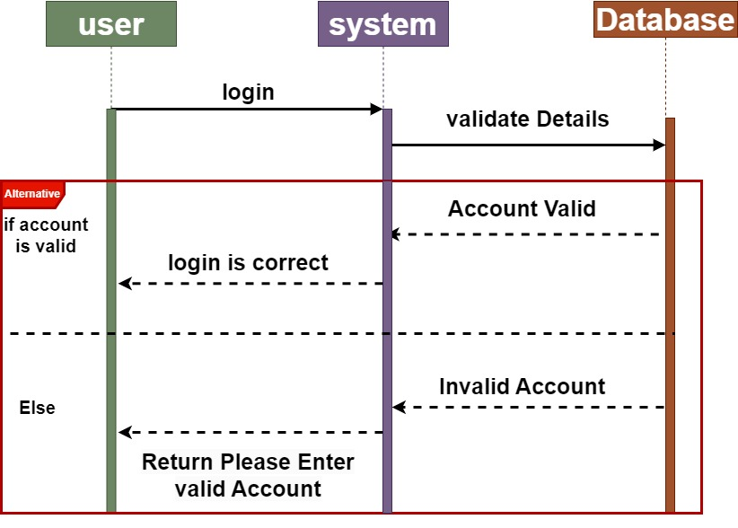
Sequence diagram login for user
.

Slide 39
login Description FOR user
* The User sends a login request with user details (Username, Password, Email, etc.) to the System.
* The System validates the user details .
*The System sends the validation result (Valid/Invalid) to the User.
*If the details are valid:
The System sends the login is correct message to the User.
*If the details are invalid: The System sends Return Please Enter valid Account .

Slide 40
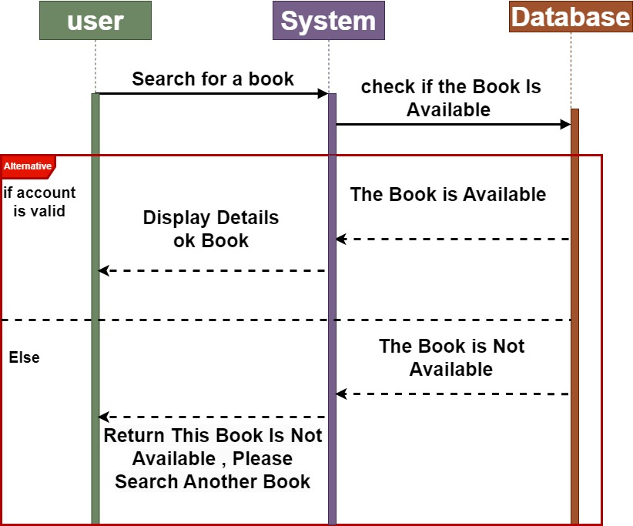
Sequence diagram search for user
.

Slide 41
search Description FOR user
* The User sends request search for book to the System.
* The System queries the Database to retrieve matching books.
*if the book is avaliable :
The Database sends the search results (Matching Books) to the System.
*if the book is not avaliable :
The Database sends This Book Is Not Available , Please Search Another Book

Slide 42
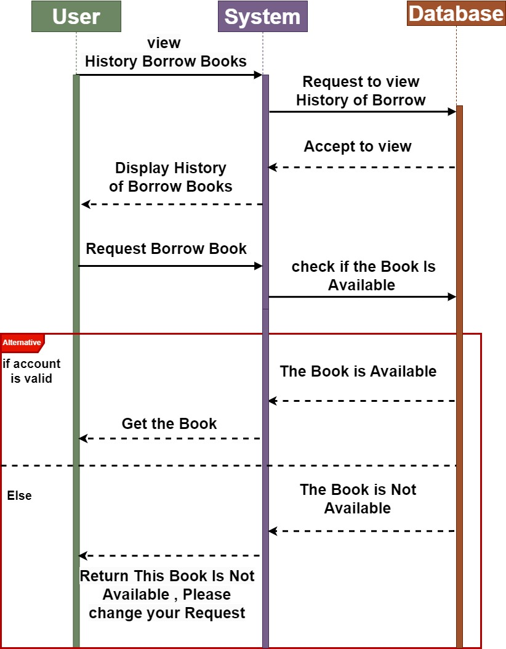
Sequence diagram View History Borrow Books and Borrow book for user
.

Slide 43
View History Borrow Books and Borrow book Description FOR user
* The User sends a View History Borrow Books request to the System.
*The System request View History Borrow Books from database and view it to user
*The User sends a Borrow Book request to the System.
*if the book is avaliable :
The system send to user can get the book
*if the book is not avaliable :
The system send to user This Book Is Not Available , Please change your Request

Slide 44
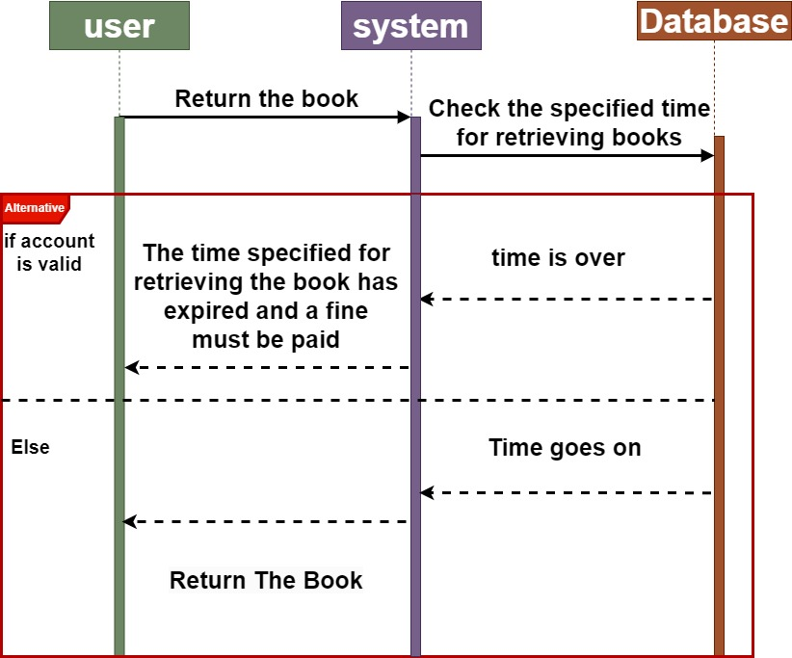
Sequence diagram Return Book
for user
.

Slide 45
Return Book Description FOR user
* After the user finishes reading the book, he retrieves it.
* The system Check the specified time for retrieving books.
*if time is over:
The System sends The time specified for retrieving the book has expired and a fine must be paid.
*If the Time goes on: The System sends Return The Book.

Slide 46
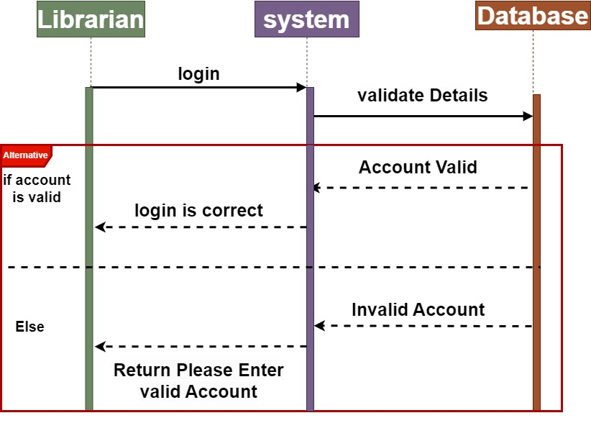
Sequence diagram login for Librarian
.

Slide 47
login Description FOR Librarian
* The Librarian sends a login request with user details (Username, Password, Email, etc.) to the System.
* The System validates the user details .
*The System sends the validation result (Valid/Invalid) to the User.
*If the details are valid:
The System sends the login is correct message to the User.
*If the details are invalid: The System sends Return Please Enter valid Account .

Slide 48
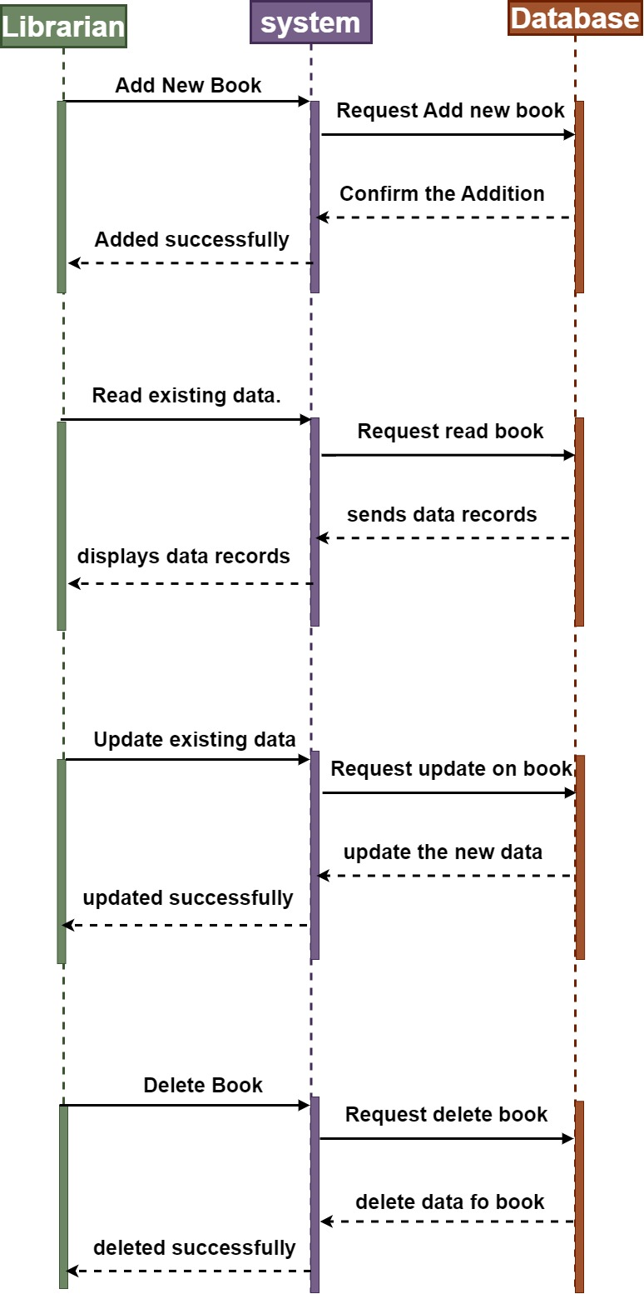
Sequence diagram CRUD Operation
for Librarian
.

Slide 49
CRUD Operation Description FOR Libraian
ADD
* The Librarian sends a Add new Books request to the System.
* The System queries the Database about Add new book.
* The System sends to librarian the Added is successfully.
READ
* The Librarian sends a Read existing data. request to the System.
* The System queries the Database about Read existing data.
* The System display to librarian the data records.
UPDATE
* The Librarian sends a update existing data. request to the System.
* The System queries the Database about update on book.
* The System sends to librarian Updated is successfully.
Delete
* The Librarian sends a Delete book. request to the System.
* The System queries the Database about delete book.
* The System sends to the Deleted is successfully.

Slide 50
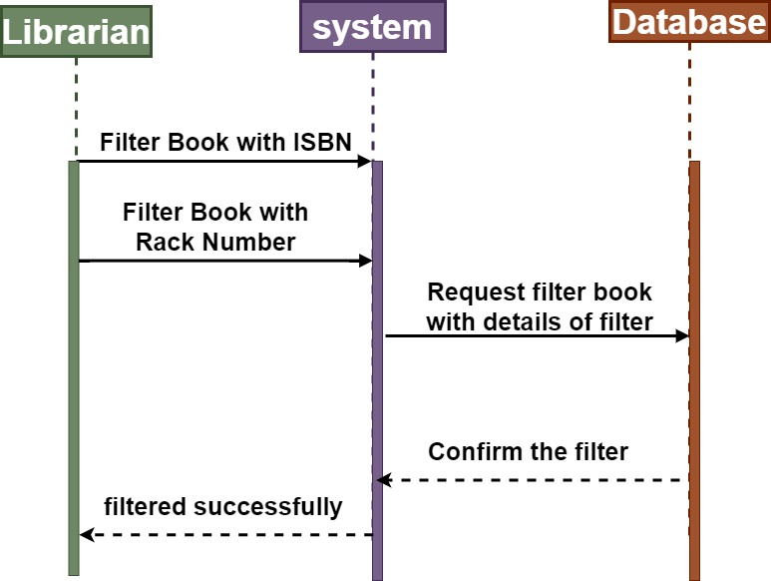
Sequence diagram filter Book
for librarian
.

Slide 51
filter Book Description FOR librarian
* The librarian filters the book by ISBN or shelf number
* The system sends a request to filter books based on the previous details
* The System sends to librarian the filterd is successfully.

Slide 52
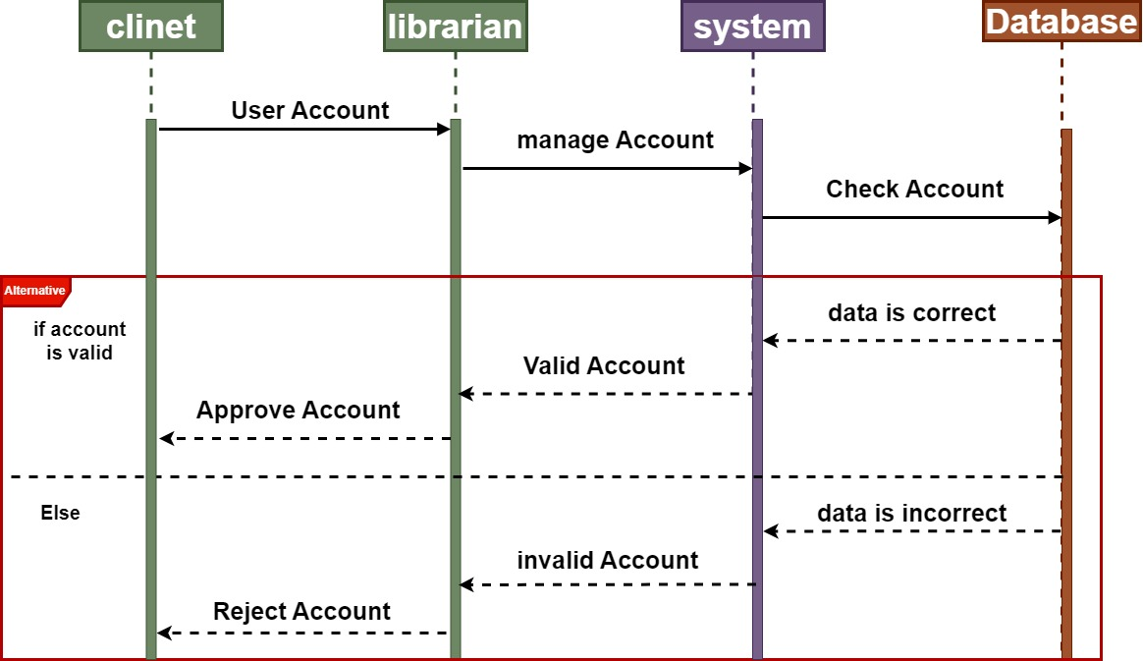
Sequence diagram Manage user Account for librarian
.

Slide 53
Manage user Account Description for librarian
* After the user login his account in the library, he sends the account to the librarian for approve or rejection fot his account.
* the librarian Sends to the system to manage the user account
* The system sends to the database to check this account
* If the data is correct, the system sends the librarian a valid account, and the librarian then begins sending a message to the user approving the account.
* If the data is incorrect, it is correct. The system sends the librarian an invalid account, and the librarian then begins sending a message to the user rejecting the account.
.

Slide 54
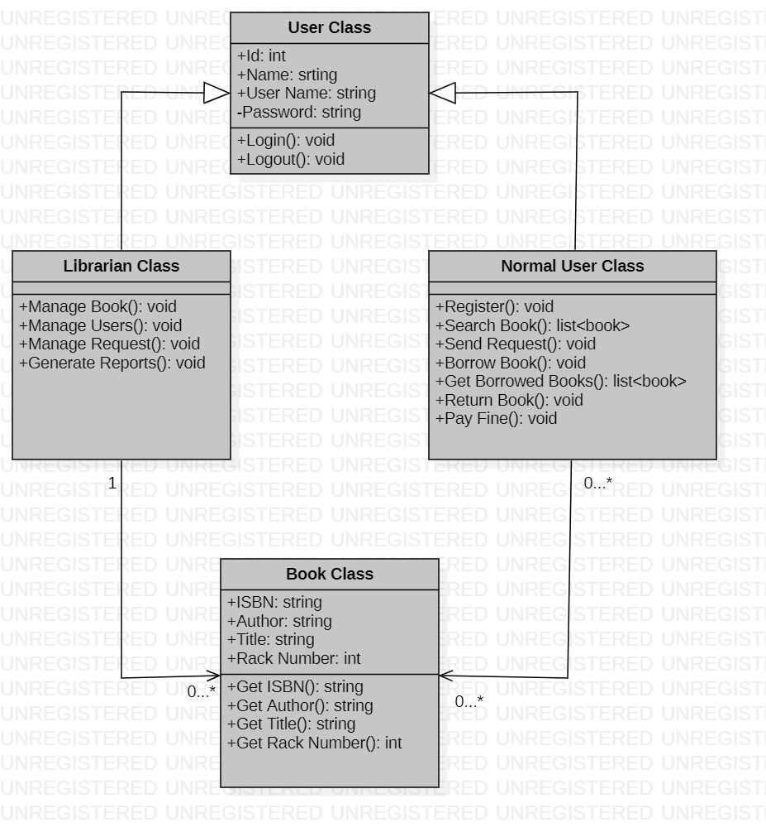
class diagram
.

Slide 55
Class Diagram Description
In our system we have four classes:
1-User Class: has(Id, Name, User Name, Password) attributes and (login(), log out()) functions.
2-Librarian Class: has(Manage Book(), Manage users(), Manage Request(), Generate Report()) functions.
3-Normal User Class: has(Register(), Search Book(), Send Request(), Borrow Book(),Get Borrowed Book(), Return Book(), Pay Fine()) functions.
4-Book Class: has(ISBN, Author, Title, Rack Number) attributes and (Get ISBN(),Get Author(), Get Title(), Get Rack Number()) functions.
* we have Generalization relationship which subclasses(Librarian and Normal Userclass) inherits attributes and behaviors from another class (User Class) the superclass we have Association relationship between(Librarian Class,Normal User Class) and Book Class which one Librarian can manage from zero to many book, and from zero to many Normal User can borrow from zero to many Book.

Slide 56
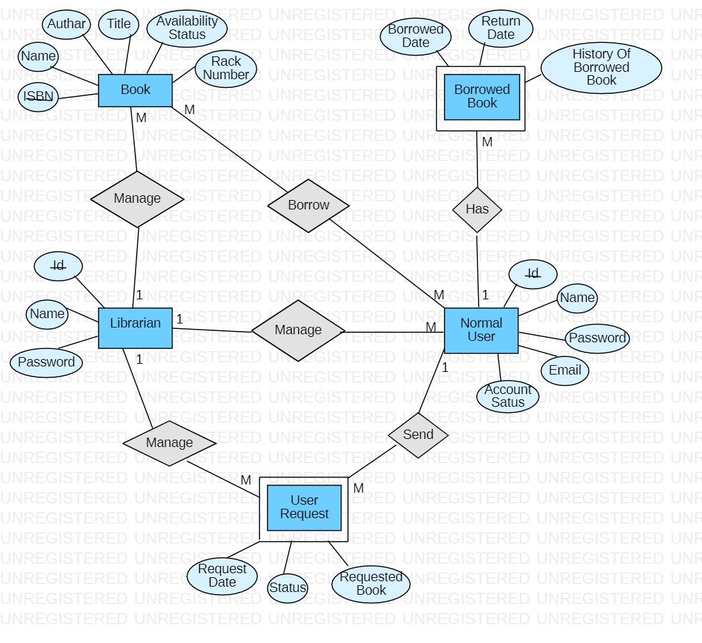
ERD diagram
.

Slide 57
ERD Diagram Description
In our system we have five entities:
(Librarian, Normal User, Book, Borrowed Book and User Request), this entities have attributes
* Librarian entity has (Id, Name and Password),
* Normal User entity has (Id, Name, Password, Email and Account Status),
* Book entity has (ISBN, Name, Author, Title, Availability Status and rack Number),
* Borrowed Book entity has (Borrowed Date, Return Date and
* History Of Borrowed Book AND User Request entity has (Request Date, Status and Requested Book)
we have some relationships between this entities, that we have :
1:M relationship between Librarian and Book
1:M between Librarian and Normal User
1:M between Librarian and User Request
1:M between Normal User and Borrowed Book
1:M between Normal User and User Request
M:M between Normal User and Book

Slide 58
OCL

Slide 59
Conclusion
The Library Management System aims to streamline the library operations, making it easier for the librarian to manage resources and for users to access and borrow books efficiently.
With features like user management, book management, searching capabilities.
the system provides a comprehensive solution for library management needs.

Slide 60
THANK YOU
.

